Slide 1


Philippines
Refugee Statistics,
2012-2022:
An Applied Data-Mining
and Visualization Study
Emerson C. Antic
October 11, 2026

Slide 2
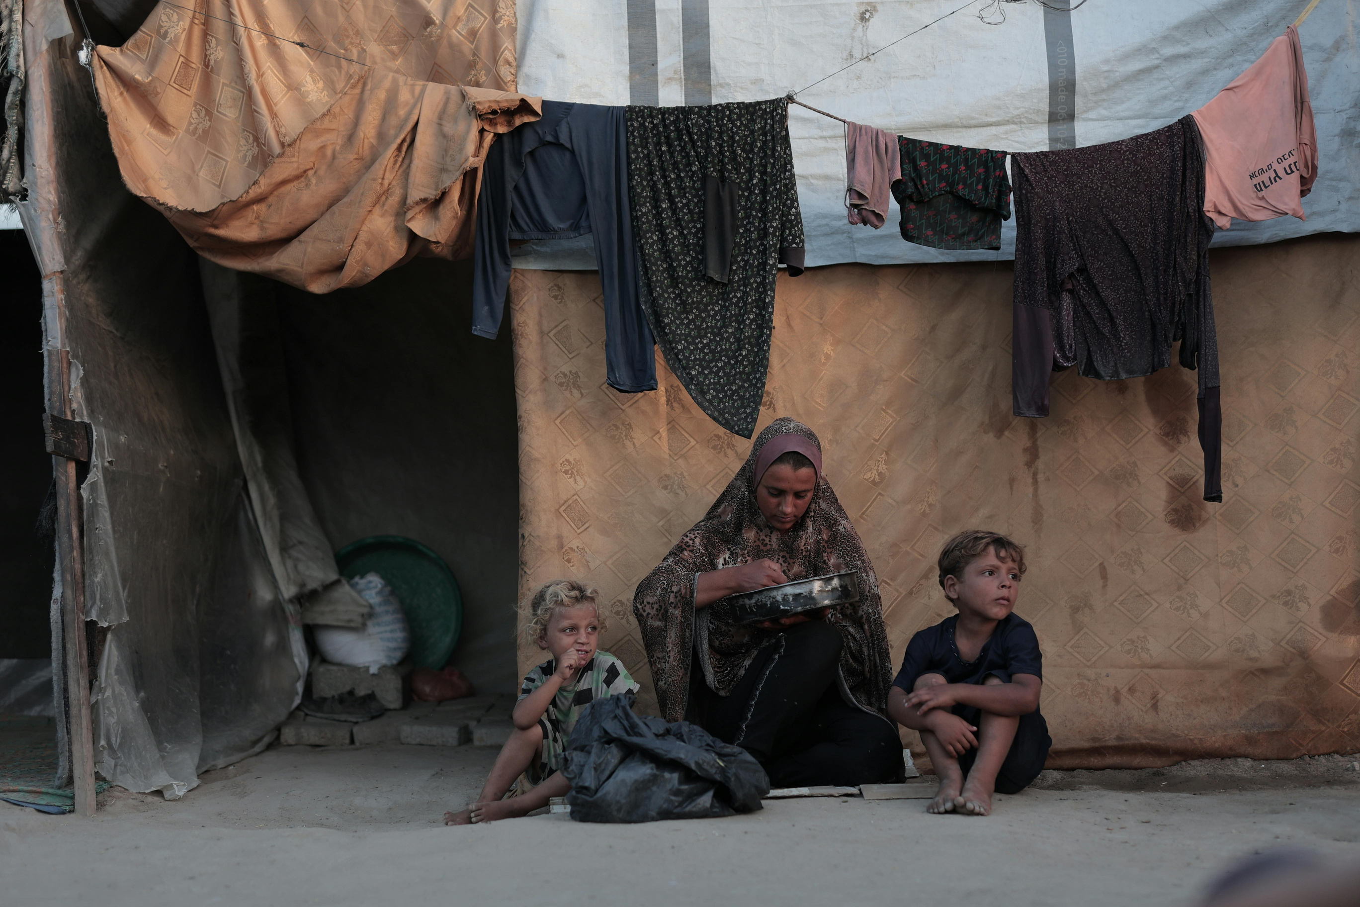


Purpose and Research Questions
Examine annual changes in refugee and asylum-seeker counts recorded in the Philippines
Identify countries of origin with the largest refugee populations
Compare refugees with asylum-seekers by counts and trends
Detect notable changes by country over time
Describe historical patterns without inferring causes or social effects

Slide 3



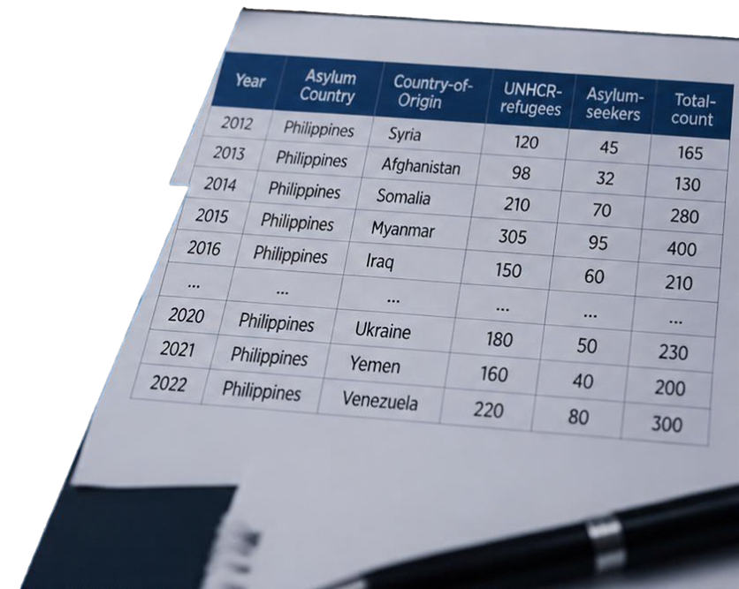


Dataset and
Variable Classification
11
31
THREE TYPES
years of data
2012-2022
countries represented
of variables
QUALITATIVE
QUANTITATIVE
RELATIONSHIP
Year
temporal / ordinal
Asylum Country
Country-of-Origin
nominal
Total-count
=
UNHCR-refugees
+
Asylum-seekers
UNHCR-refugees
Asylum-seekers
Total-count
discrete
DATA QUALITY CONSIDERATIONS
Verify “Asylum Country” meaning per original documentation
Check for missing values, duplicates, inconsistent country names
Confirm Total-count = UNHCR-refugees + Asylum-seekers per row
Dataset does not confirm physical residency or causal factors

Slide 4



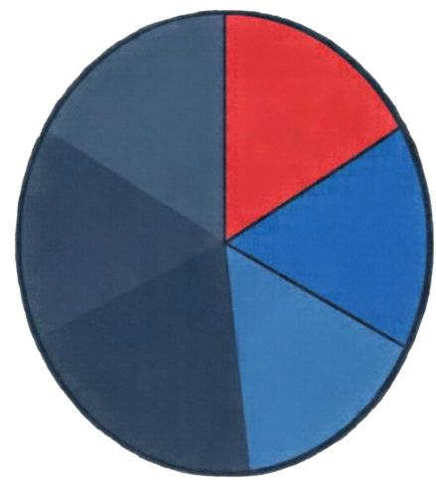

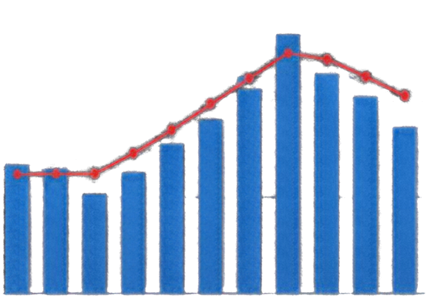
Visualizations from the Report
Key visual tools that reveal refugee and asylum-seeker patterns in the Philippines.
OVERVIEW SCORECARD
COUNTRY-OF-ORIGIN SHARES
ASYLUM-SEEKERS OVER TIME
Yearly counts
Trend line
512
Total refugees
300
15.0%Pakistan
Total asylum-seekers
210
200
14.5%Syria
Combined total
individuals
722
100
12.9%Iran
31
Countries represented
0
2012 2013 2014 2015 2016 2017 2018 2019 2020 2021 2022
Other countries

Slide 5

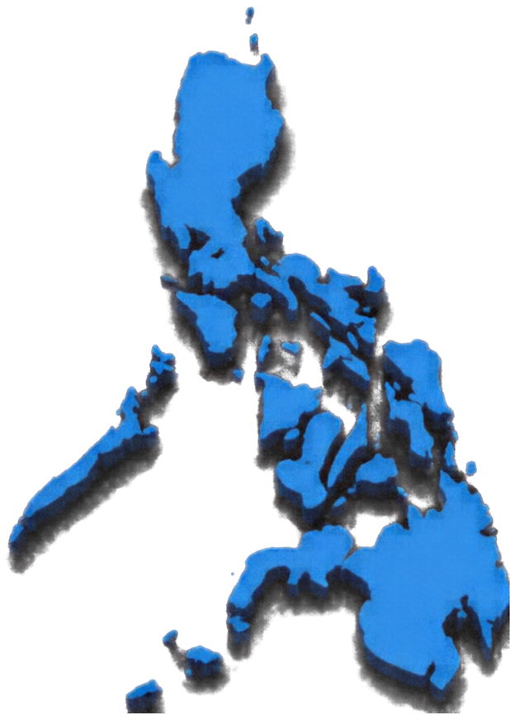

Key Findings
Total recorded population
512
722
Refugees
210
individuals over 11 years
Asylum-seekers
Largest country-of-origin shares
Steady upward trend in refugee
and asylum-seeker counts
Pakistan 15.0%
Average annual asylum-seeker
count: approx. 28.5
Syria/Syrian Arab Republic 14.5%
Iran 12.9%
Average cumulative baseline population: approx. 293.4 individuals

Slide 6


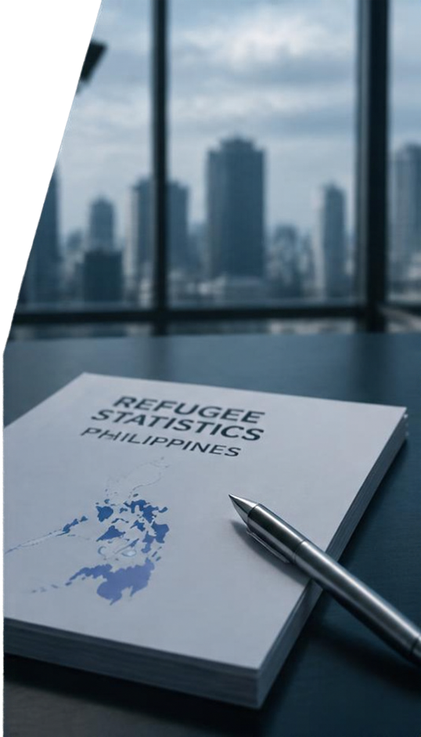



Limitations and
Conclusion
LIMITATIONS
CONCLUSION
Dataset alone cannot establish causes or social impacts
This report provides a descriptive longitudinal overview of refugee statistics related to the Philippines
Possible inconsistencies or ambiguities in variable definitions and data quality
Findings serve as a basis for further research and exploration with caution
Do not assume physical residency or effects without verified context

Slide 7



References
Pagaduan, O. (n.d.). Philippines refugee
statistics 2012–2022 [Data set]. Kaggle.
Mohamed Ahmed, A. (n.d.). Canada refugee
stats EDA [Computer software].GitHub: https://github.com/alaa-mohamedahmed/
canada-refugee-stats-eda
Report prepared by Emerson C. Antic,
October 11, 2026, for DATA 502 - Data Mining,
Activity 1

